Slide 1

One try block can be nested within another. An exception generated within the inner try block that is not caught by a catch associated with that try is propagated to the outer try block.
For example, here the ArrayIndexOutOfBoundsException is not caught by the inner catch, but by the outer catch:

Slide 2
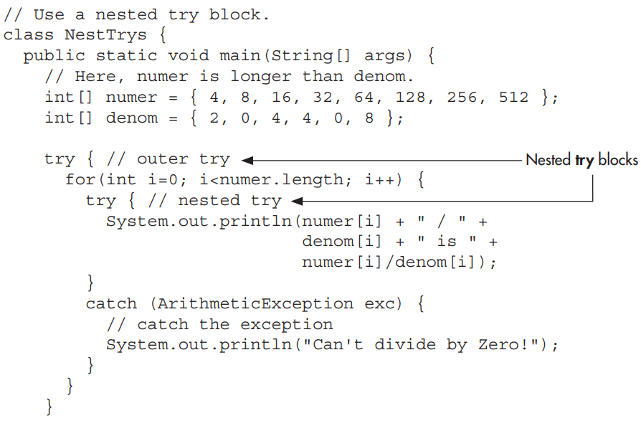

Slide 3
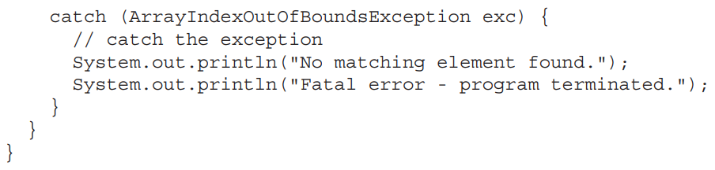

Slide 4
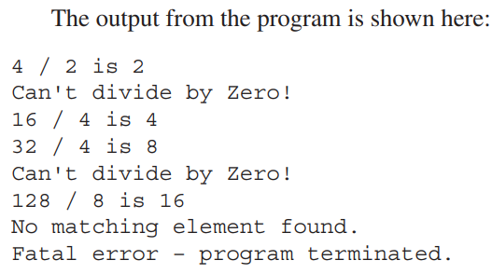

Slide 5


The preceding examples have been catching exceptions generated automatically by the JVM.
However, it is possible to manually throw an exception by using the throw statement.
Its general form is shown here:

Slide 6
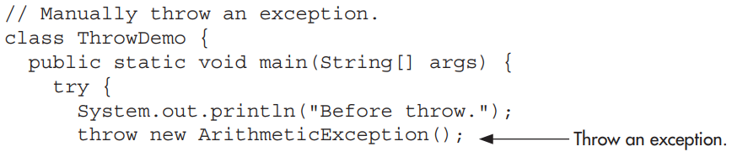
Here is an example that illustrates the throw statement by manually throwing an ArithmeticException:

Slide 7
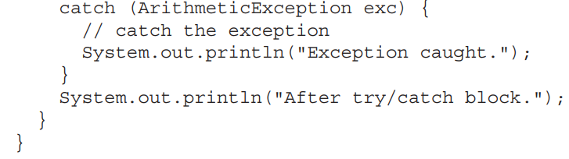

Slide 8
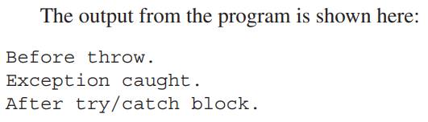

Slide 9

An exception caught by one catch statement can be rethrown so that it can be caught by an outer catch.
The most likely reason for rethrowing this way is to allow multiple handlers access to the exception.
For example, perhaps one exception handler manages one aspect of an exception, and a second handler copes with another aspect.

Slide 10
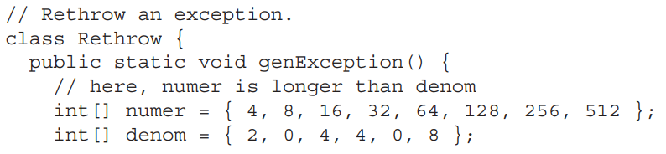

Slide 11
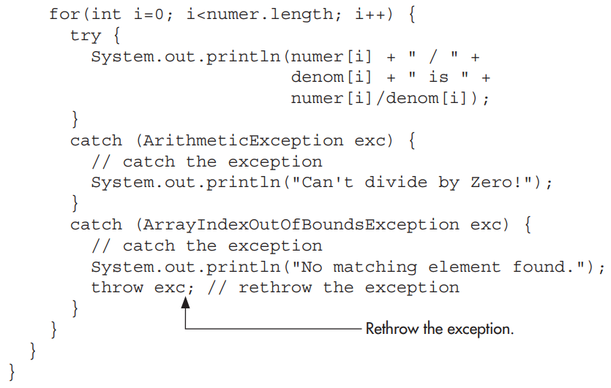

Slide 12
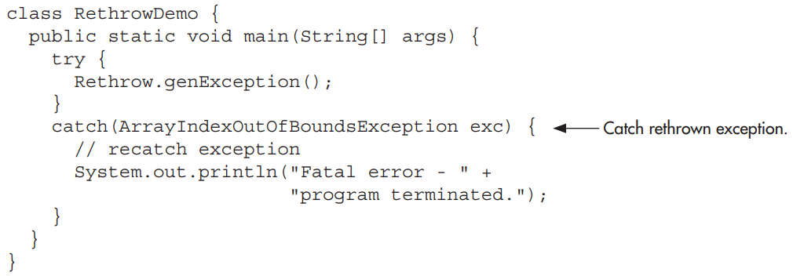

Slide 13

Since all exceptions are subclasses of Throwable, all exceptions support the methods defined by Throwable.
Several commonly used ones are shown in the following Table.
Of the methods defined by Throwable, two of the most interesting are printStackTrace( ) and toString( ).

Slide 14
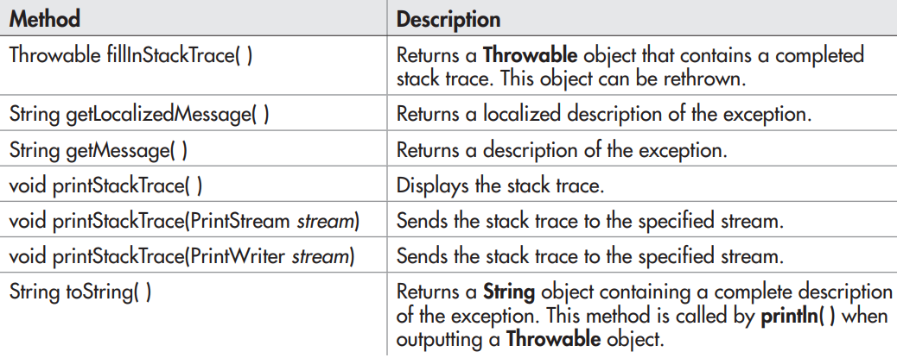

Slide 15
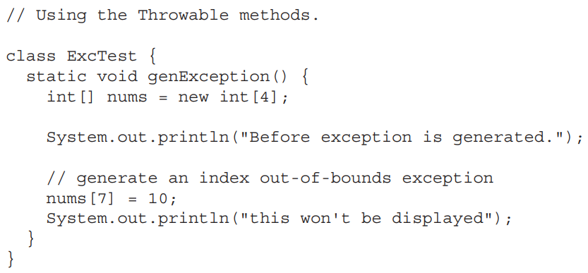

Slide 16
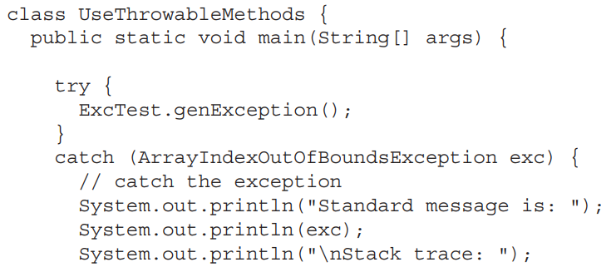
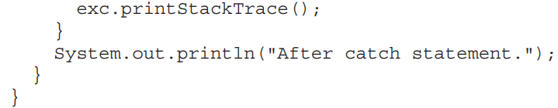

Slide 17
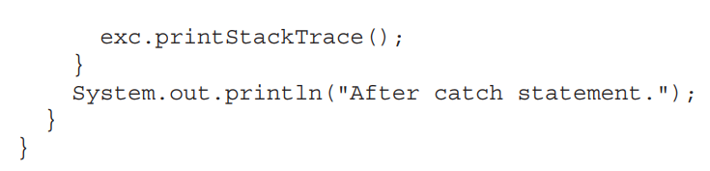

Slide 18
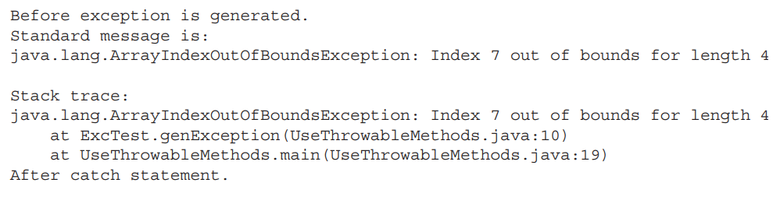
Output may vary because of JDKs version

Slide 19

Sometimes you will want to define a block of code that will execute when a try/catch block is left.
For example, an exception might cause an error that terminates the current method, causing its premature return. However, that method may have opened a file or a network connection that needs to be closed.
Such types of circumstances are common in programming, and Java provides a convenient way to handle them: finally.

Slide 20
To specify a block of code to execute when a try/catch block is exited, include a finally block at the end of a try/catch sequence.
The general form of a try/catch that includes finally is shown here.

Slide 21
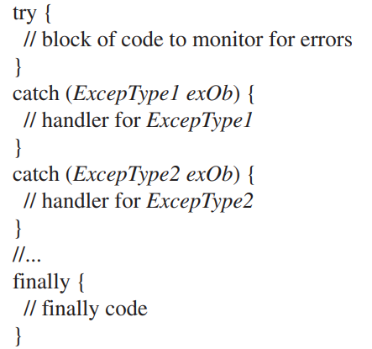

Slide 22
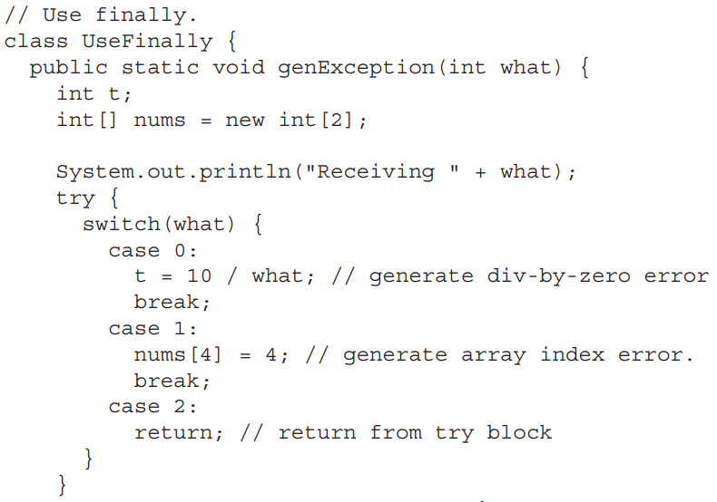
Here is an example of finally:

Slide 23
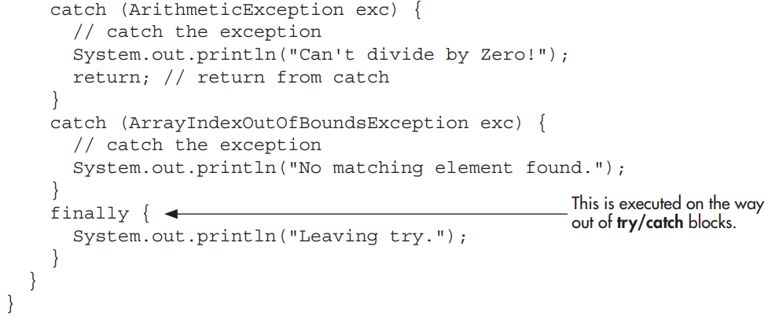

Slide 24

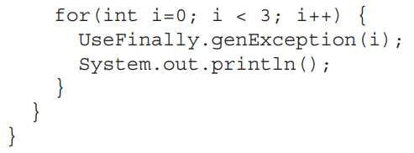

Slide 25
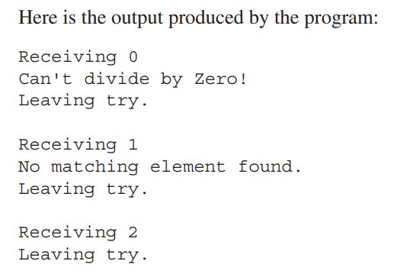

Slide 26

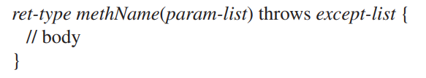
In some cases, if a method generates an exception that it does not handle, it must declare that exception in a throws clause.
Here is the general form of a method that includes a throws clause:

Slide 27
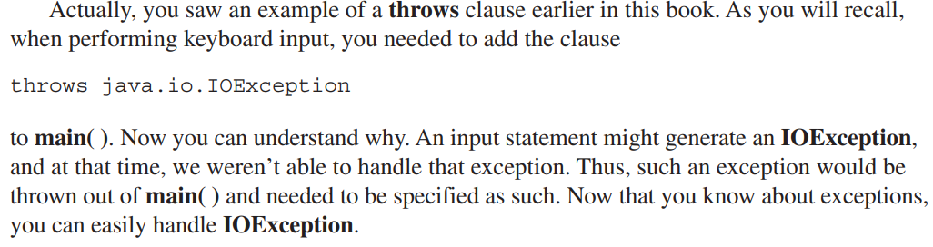

Slide 28
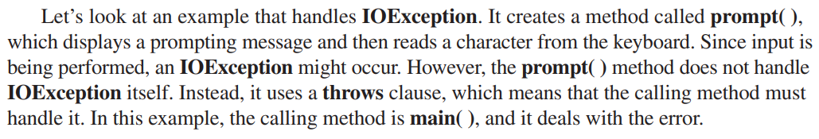
However, the prompt( ) method does not handle IOException itself.
Instead, it uses a throws clause, which means that the calling method must handle it.

Slide 29
